Slide 1
Brain Book
LET'S GET STARTED
Submitted to : Mr. SK. Ansari

Slide 2
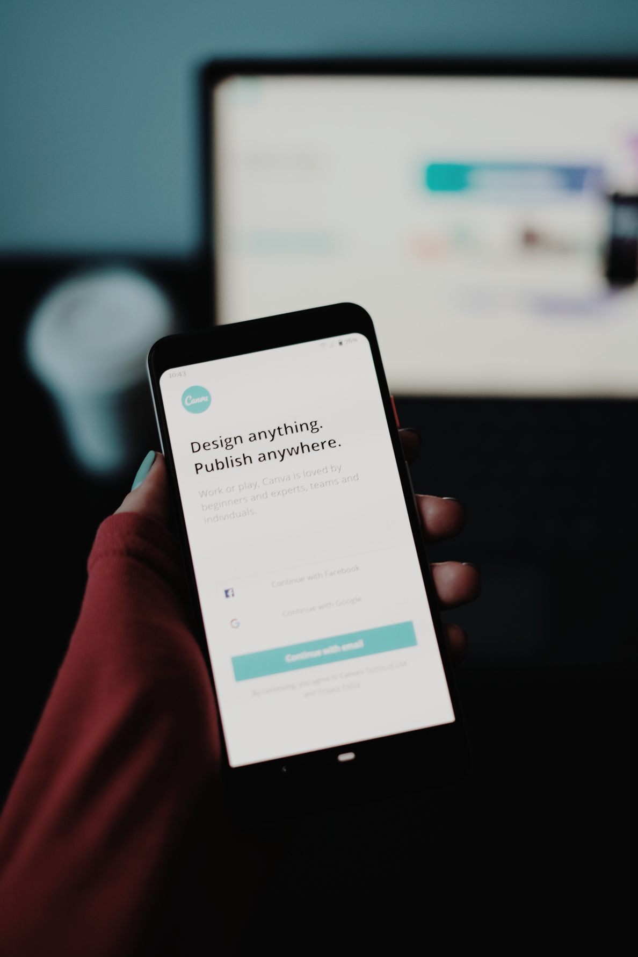
Introduction
Brain Book is a sticky notes web application built using React, Tailwind CSS, and React Router. It allows users to create, manage, and search notes in a user-friendly interface. The application includes features such as note creation, search functionality, user authentication, and responsive design. It leverages React's Context API for state management and provides a seamless experience for organizing and accessing notes.

Slide 3
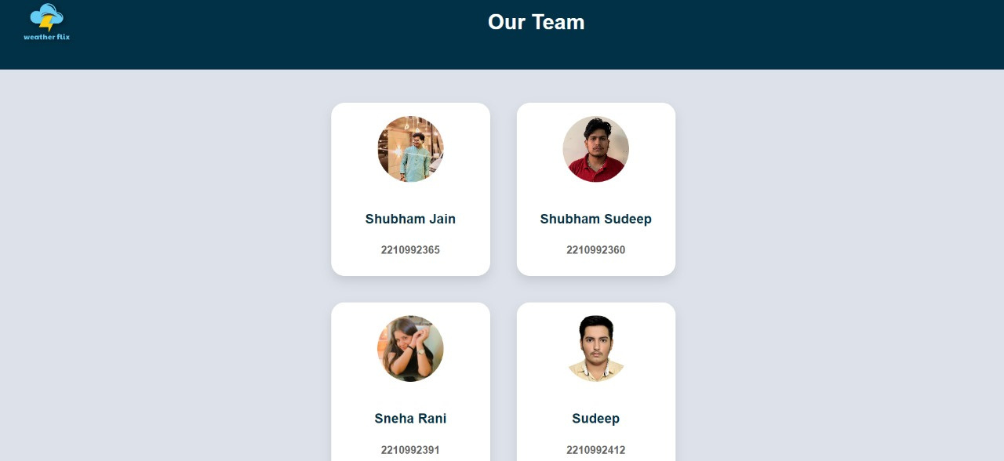
Our Team

Slide 4
Efficient Note Organization
01
Brain Book offers a user-friendly interface for creating, managing, and organizing digital sticky notes effectively.
Problems
Advanced Search Functionality
02
The app includes a robust search feature, enabling users to quickly locate specific notes by title or content, streamlining the retrieval of important information.
Statement
Responsive Design and User Authentication
03
Built with React and Tailwind CSS, Brain Book ensures a seamless user experience across devices. It also incorporates user authentication for secure login and personalized access to note collections.

Slide 5
Solutions Offered
01
02
Notes Management System
Advanced Search Capability
Brain Book provides a comprehensive platform for users to create, edit, and delete digital sticky notes. Users can organize their notes by categories or tags for better management.
The app features a powerful search function that allows users to search for notes based on keywords, titles, or content. This enables quick retrieval of specific information from a large collection of notes.

Slide 6

Objectives
Enhanced Note-taking Experience
User-Friendly Interface
Customizable Note Organization

Slide 7
Technical Details
HTML: Structure and content.
CSS: Styling, layout, responsiveness.
JavaScript : Interactivity, animations, API calls.
React: React is a JavaScript library for building user interfaces

Slide 8

Project TimeLine : From Concept To Launch
Planning and Research
Checking and Refinement
Feature Expansion
(Conducted research and define project objectives)
(Conduct usability testing)
(Plan for future updates and enhancements.)
Development
Submission of the Project
(Coding the website and adding functionality.)
(Launch website and monitor performance.)

Slide 9
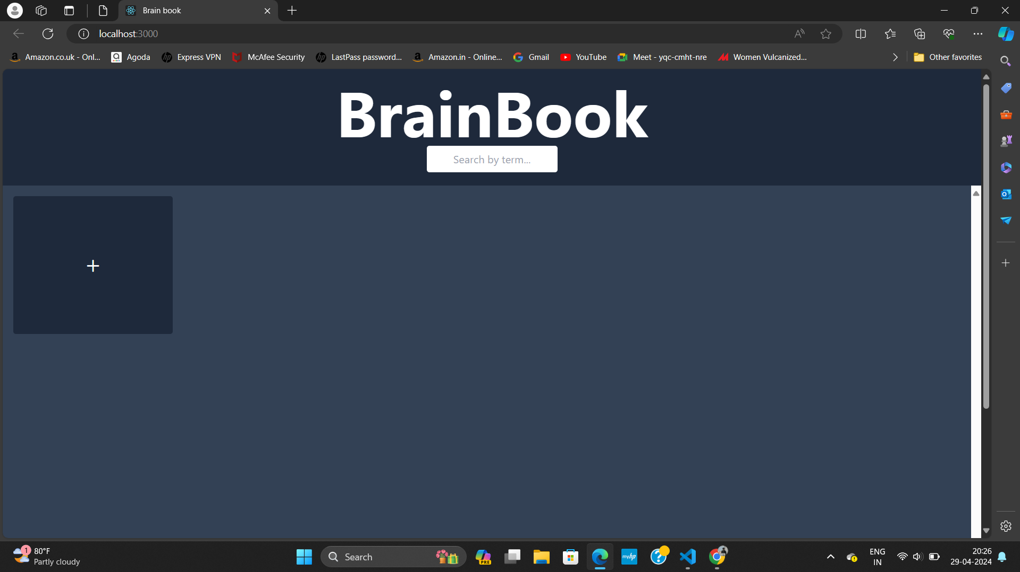
Project Highlights

Slide 10
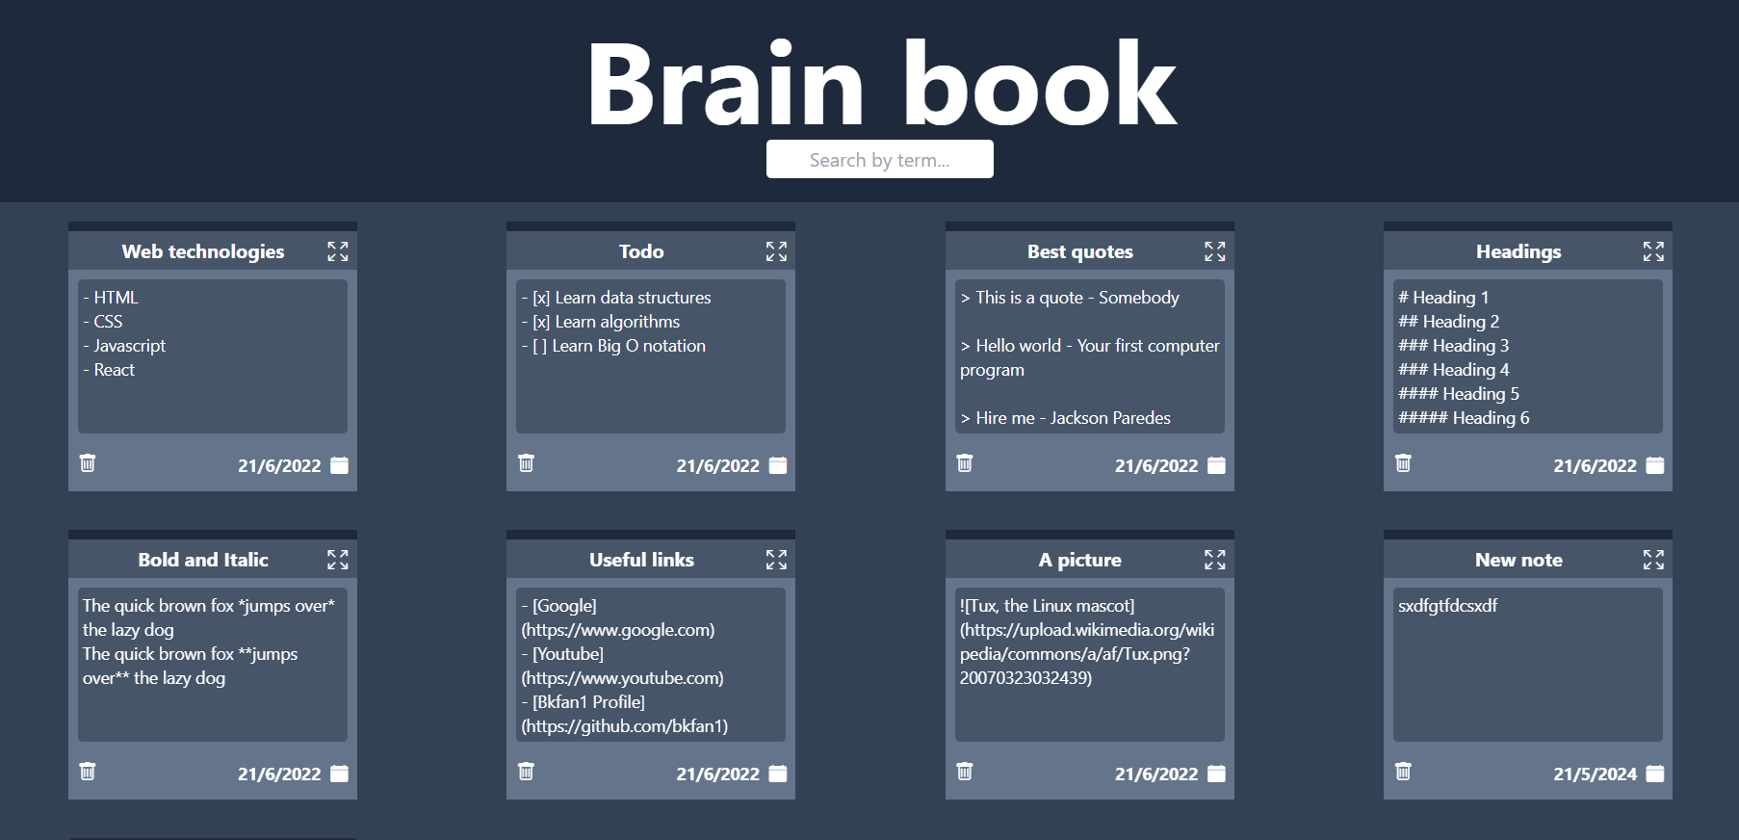
Project Highlights

Slide 11
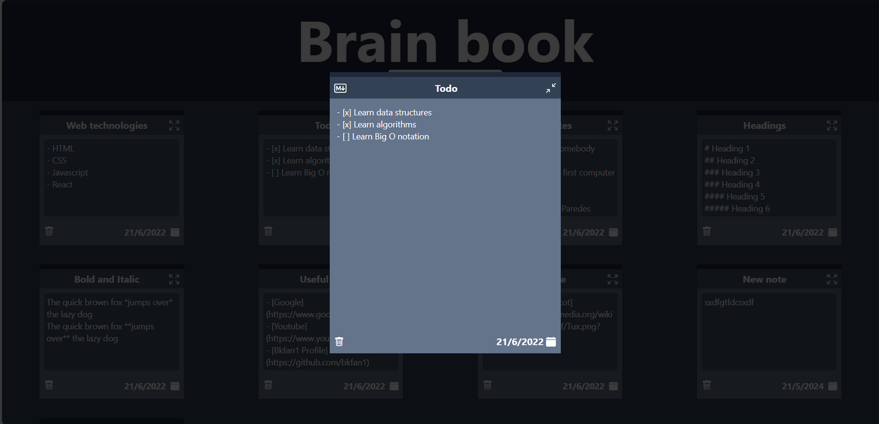
Project Highlights

Slide 12
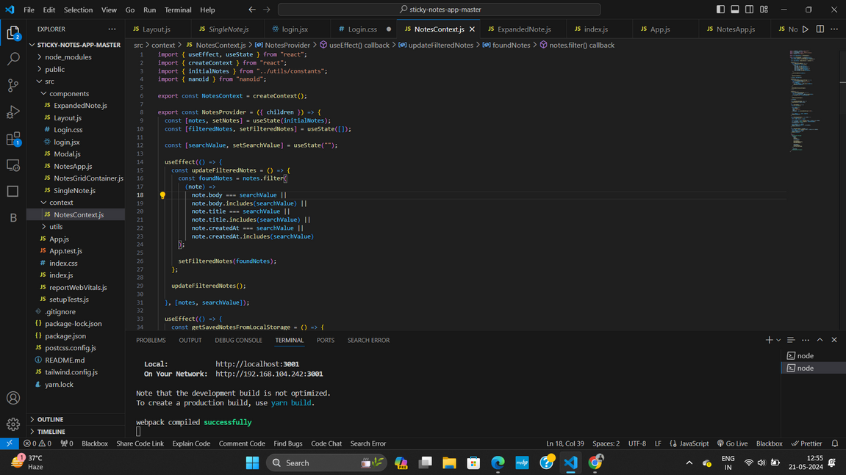
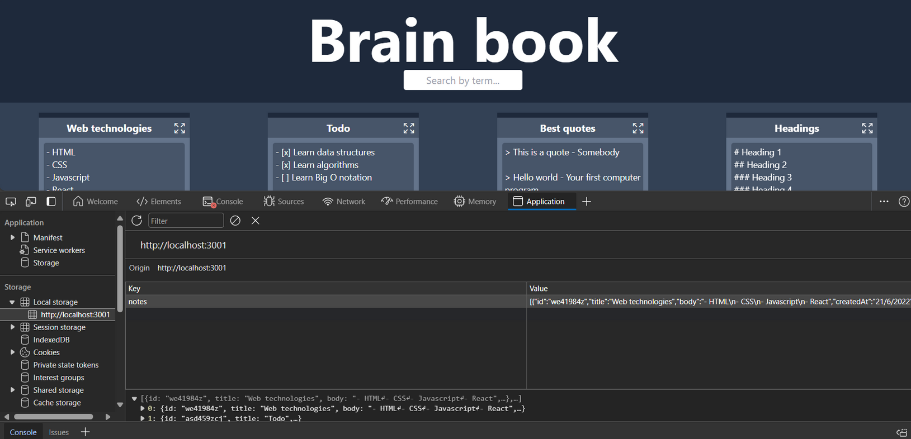
Code Snippets
Local Storage Used

Slide 13
Key Features
Note Creation
Local Storage
Delete Functionality
Users can create new notes with titles and content.
Notes are stored locally in the browser using Local Storage, ensuring data persistence across sessions.
Users can delete notes they no longer need, helping them manage their notes effectively.

Slide 14
Conclusion
User-friendly note creation and management interface.
Efficient search functionality for easy access to notes.
Integration of local storage for seamless data persistence.
Responsive design ensuring compatibility across devices.

Slide 15
Thank You

